Slide 1
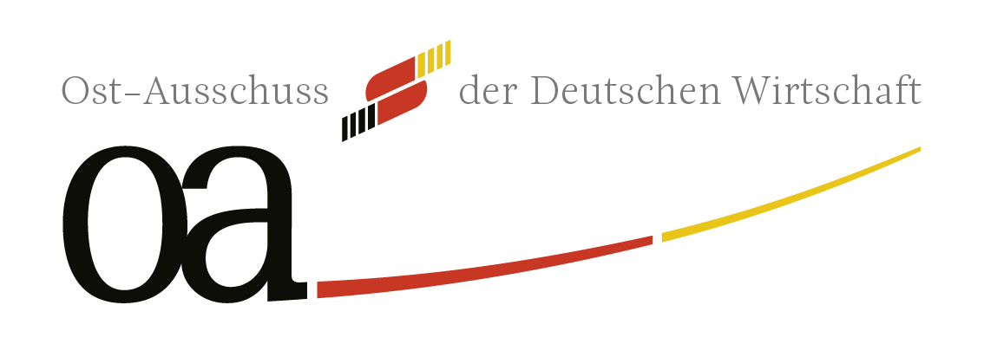
Investment Opportunities in Eastern Europe an IFC Perspective
Sacha Backes (sbackes@ifc.org)
Jonas Knapp (jknapp2@ifc.org)
June 2025

Slide 2

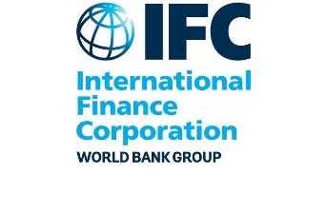


International Finance corporation
A Member of the World Bank Group
IBRD
International Bank for Reconstruction and Development
IDA
International Development Association
IFC
International
Finance
Corporation
MIGA
Multilateral
Investment
Guarantee Agency
ICSID
International Centre for Settlement of Investment Disputes
Loans to middle-income
and low-income country governments
Interest-free loans and grants to governments
of poorest countries
Solutions
in private-sector development
Guarantees for foreign direct investment’s
non-commercial risks
Conciliation and arbitration of investment disputes
2
Notes:
IBRD and IDA … G
ov
MIGA private sector PRI
ICSID … arbitration
We can leverage each other’s competencies and mandates in support of our clients.

Slide 3
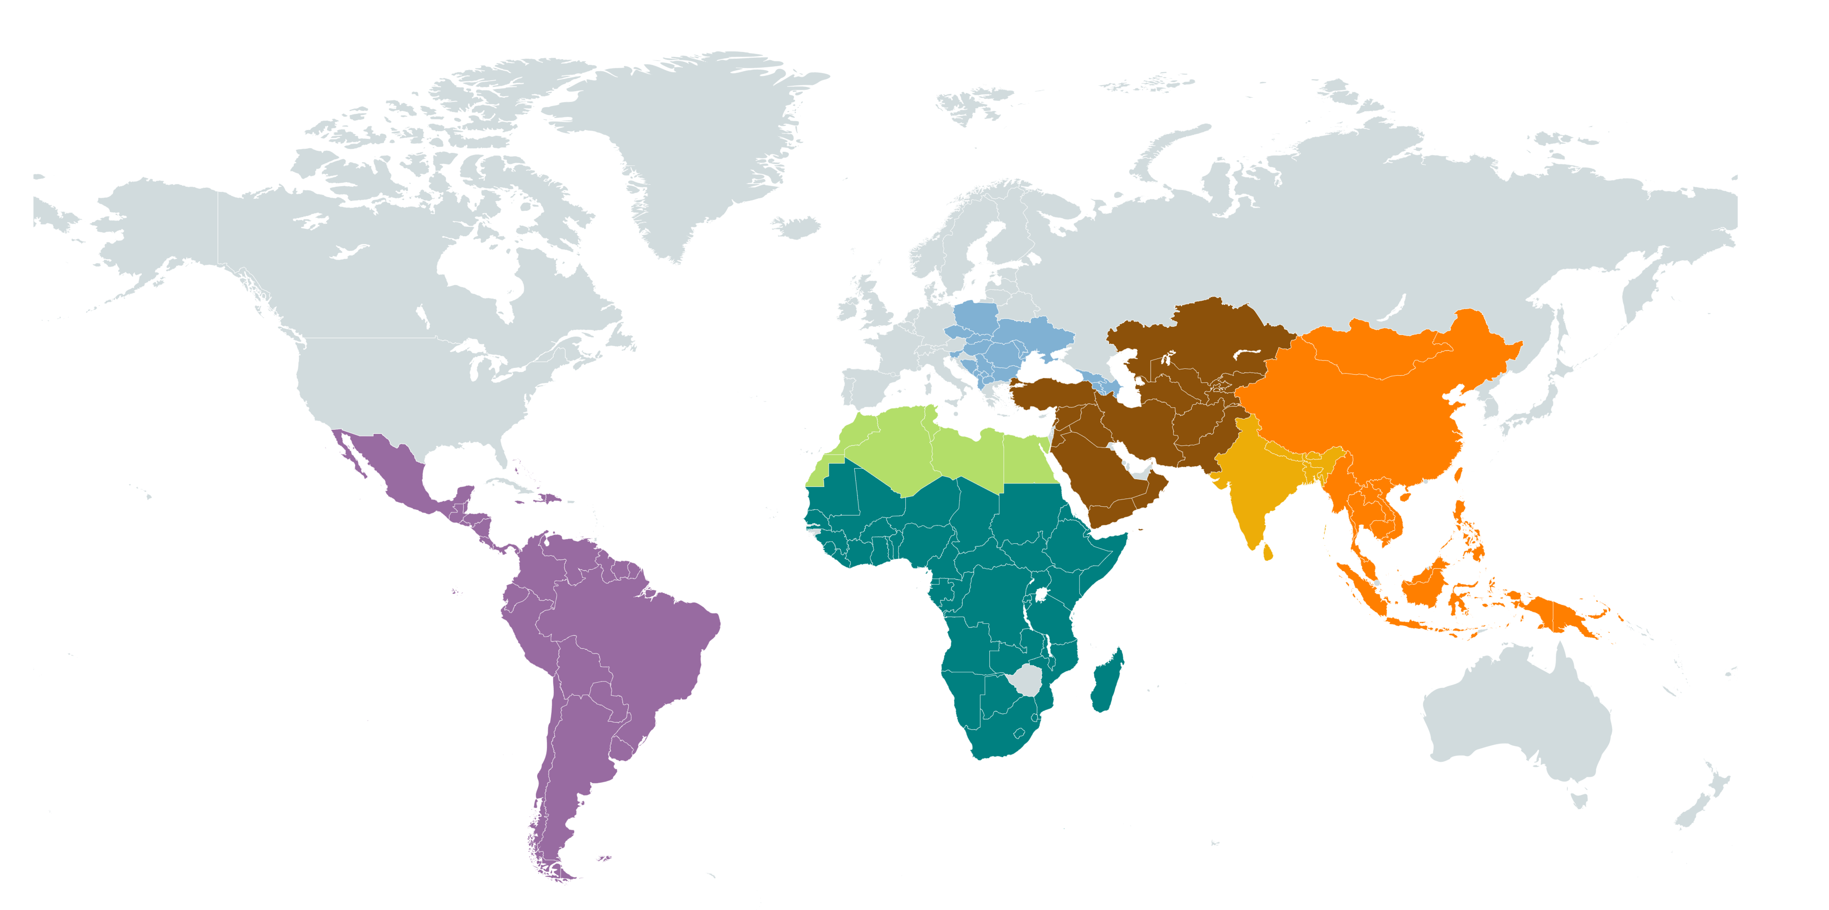
IFC - A Development finance institution on a Global Scale
  FY 2024 Portfolio*: US$80 billion
  FY 2024 Commitments*: US$22 billion
Triple-A credit rating
Founded 1956
Owned by 186 countries
Investments in +100 countries
Own account By sector
Others
Global
8% ($6bln)
Trade finance
Middle East, Central Asia, Türkiye, Afghanistan, and Pakistan
11% ($9 bln)
Agribusiness & Forestry
Tourism, Retail & Property
Manufacturing
Infrastructure
Europe
9% ($7bln)
Financial Institutions
East Asia &
The Pacific
17% ($14 bln)
Own account By product
Other instruments
South Asia
13% ($10 bln)
Equity / Quasi-Equity
Latin America &
the Caribbean
21% ($17bln)
Africa
21% ($17 bln)
Loan / Quasi-Loan
* IFC own account only
3

Slide 4
IFC’s PRODUCTS AND SERVICES
Integrated Solutions for increased impact and value add
Upstream / Early-Stage Projects
IFC’s Core Business: Investment
Advisory Services
IFC can co-finance and design / implement early-stage projects with its clients, thereby creating markets / eliminating bottlenecks:
  Early-Stage Project Development covering project-specific engagements with sponsors (e.g. pilot projects, feasibility studies, FEED activities, regulatory reviews, market assessments, sustainability strategies).
  Create new markets and opportunities via sector-wide initiatives and country-specific interventions.
  Global-Delivery Platforms - design / development of scalable solutions applicable to multiple projects in a sector
IFC’s core business is to finance businesses in emerging markets, using:
Loans
  Project and corporate financing
  Sustainable financing products
Equity
  Direct equity investments
  Private equity funds
Trade and Commodity Finance
  Guarantee of trade-related payment obligations
Derivative and Structured Finance
  Derivative products to hedge interest rate, currency, or commodity-price exposures
Blended Finance
  Donor funds to crowd in private financing
Innovation via:
  In-house expertise to reduce risks and costs, and increase social license to operate, by augmenting ESG standards, and increasing sustainability and risk management
  Advisory support for sustainability strategies and sustainable finance frameworks
  $270 million program in 2024
Mobilizing Financing
Syndications
  Capital mobilization for large projects
  Over 80 co-financiers: banks, funds, DFIs
Equity mobilization
  $43 billion five-year upstream pipeline in 2024
  $22 billion new commitments in 2024
  $23 billion mobilized in 2024
4

Slide 5
IFC’s support to strengthen corporate balance sheets
Four key value-adds:
Lending with aligned terms and conditions
Aligned key terms and conditions: IFC can largely follow the key terms and conditions agreed with commercial banks
Aligned documentation: IFC can generally follow existing standard documentation to be efficient and fast
Material amounts: Large-ticket IFC own-account financing, with high likelihood of repeat transactions
Sustainable finance: IFC provides and helps structure sustainable financing, reducing risk of “green washing”, ensuring positive market reception, and diversifying liquidity sources
Risk mitigation: IFC reduces risks, especially ESG and political risks, and increases credibility vis a vis institutional investors, Governments, NGOs and other stakeholders
Value creation: tailored solutions for sustainable business growth, through partnerships, global and local networks, enhancing confidence of internal and external stakeholders
Aligned with house banks
Unique to IFC
Same as house banks
1
1.1
Aligned key terms and conditions
1.3
Large financing tickets
3.
Risk mitigation
2.
Sustainable financing
1.2
Aligned documents
4.
Value creation
IFC’s value proposition
Unique to IFC
2
3
4
5

Slide 6
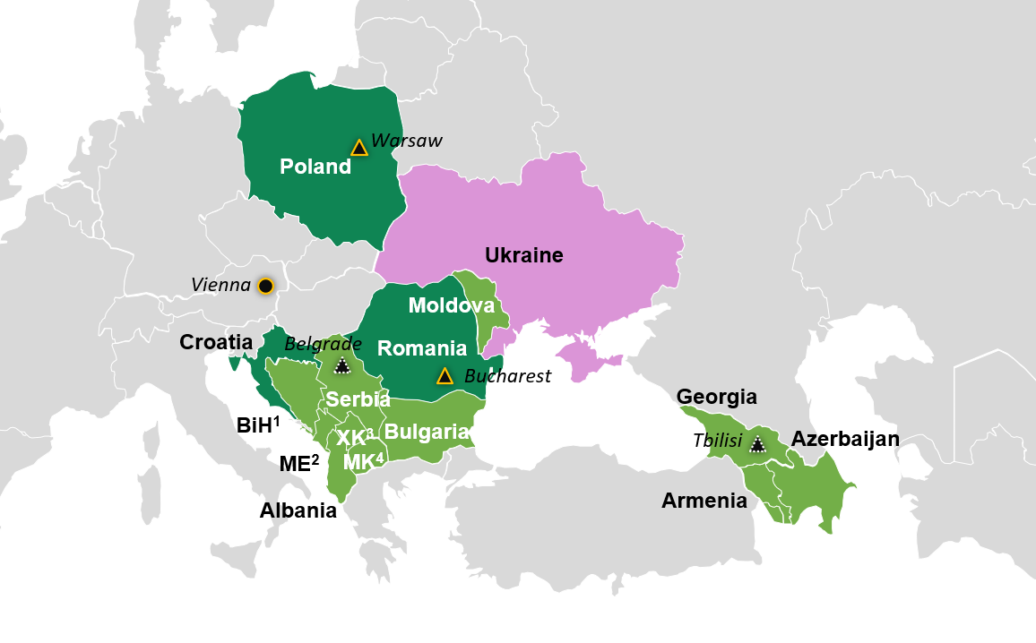
Eastern EUROPE STRATEGIC PRIORITIES – Europe’s innovation hub
Climate
1
Decarbonizing industries – manufacturing, with a focus on hard-to-abate industries, tourism, food retail, industrial property and agribusiness. (Low Carbon Industrial Hubs - CCS)
Low carbon mobility – supporting investments in developing e-mobility ecosystems.
Circular economy – supporting investments in materials recycling and minimizing waste.
2
3
Reconstruction and economic recovery
Sustainable Food Systems
Economic integration into the EU
EU accession
Productivity
1
Sustainable food systems, including food retail
Connectivity
Innovation and skill enhancement
Competitiveness
2
Climate innovation
Up-&Re-skilling
Digitization
Connectivity
3
4
Regional Integration
1
Ukraine Reconstruction and EU Integration
Small states - Western Balkans, Caucasus and Moldova
Hub
2
Satellite
Privatization reforms
Future Satellite
High Income
Regional Integration
EU accession
Competitiveness
Skill enhancement
Cross-cutting, enabling themes
Upper-middle Income
Mobilization
Digitalization
Gender
Lower-middle Income
Notes: ¹ Bosnia and Herzegovina ² Montenegro ³Kosovo ⁴ North Macedonia
6

Slide 7
Ukraine focus
The Ukraine Economic Resilience Program (ERA) builds upon decades of IFC experience operating in Ukraine:
IFC has committed c. $ 3 bln of financing to Ukraine since 1993, including deploying US$76mln (50 engagements) in advisory since 2009.
Since December 2022, IFC is a strategic advisor to the Government to help create conditions for private sector investment in reconstruction.
Phase I: Resilience During Russia's Invasion of Ukraine
Phase II: Reconstruction and Recovery
The preservation of businesses via access to risk and working capital; trade finance for critical goods; and food security and agribusiness;
Access to finance for refugees; and municipal infrastructure and housing;
Transport and logistics at the EU border, emergency energy security, and critical telecom infrastructure;
Instruments include:
  Investment support: guarantees, working capital across sectors, risk-sharing facilities with financial intermediaries; CAPEX support for business relocation and repairs / expansion of critical infrastructure;
  Advisory and Upstream support: adjusting supply chain design and logistics routs; PPPs and project development facilities for infrastructure; access to finance for refugees, NPL resolution and Upstream work on restructuring the banking and corporate sector
Revival of critical sectors, including the recapitalization of banks, agribusiness, tech/IT, distressed asset resolution
Rebuilding infrastructure such as cities and housing, transport and logistics, energy transition and security, and digital infrastructure.

Slide 8
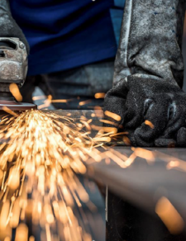
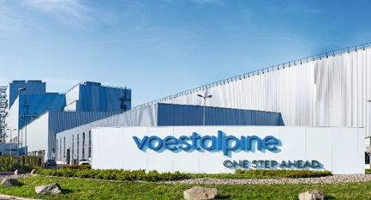
Case study: Voestalpine Green Bond (Brazil, Poland and Romania)
IFC anchored a EUR 500 million investment in voestalpine AG (“voestalpine”), a publicly-listed global producer of technologically advanced steel and metal-based products headquartered in Austria.
The proceeds of IFC’s participation will support voestalpine’s investments in boosting energy efficiency in Brazil, while also helping to decarbonize the steel supply chain in Poland and Romania.
IFC's role:
IFC’s primary role as an anchor investor was to facilitate a successful issuance by mobilizing a wide range of institutional and retail investors, resulting in oversubscription by 1.8 times.
This is amongst the Europe’s first climate bonds in the steel industry to fund decarbonization in this hard-to-abate sector. Voestalpine’s group level emission targets include Scope 1&2 and Scope 3 emission reduction by 30% and 25%, respectively.
Proceeds of the bond will be used to accelerate the decarbonization of key value chains in the steel sectors of Brazil, Poland, and Romania.
Bond Highlights
Amount | EUR 500 million
IFC amount | EUR 75 million
Currency | USD
Tenor Listing | 5 years, issued in September 2024 Vienna Stock Exchange

Slide 9

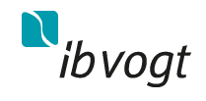


IFC’s Support for German corporates: SELECTED Examples
Türkiye
Asia
Southeast Europe
Vietnam
Egypt
Fraport
Alba
Otto Group
HDI Global
Ib.Vogt
A Loan of $163M
Upgrade and expansion of Antalya Airport in Türkiye
A Loan of $60M
Mezzanine of $40M
Support treatment of hazardous waste and biowaste projects in Asia
A Loan of $70M
Mobilized $75M
Help Resolve Non-Performing Loans, Boost New Lending in Southeast Europe
Equity of $25M
Mobilized $12M
Increase access to non-life insurance in Vietnam
A Loan of $18M
Mobilized $42M
Financing of a greenfield 50MW photovoltaic (PV) plant
2023
2022, 2020
2022
2021
2017
South Africa
Global
Indonesia
Romania
Brazil
BMW
Puma
B.Braun Melsungen
Deutsche Bank
Bertelsmann
A Loan of $150M
Upgrading the existing automotive assembly plant to produce a new BMW model in South Africa
Trade Finance
Provide financing to Puma’s suppliers under the Global Trade Supplier Finance (GTSF) program
A Loan of IDR 450B (ca. EUR 31M)
Establishment of high-quality pharmaceutical production of large-volume parenteral
A Loan of US$63M
Help Resolve Non-Performing Loans in Romania
Equity of $12M
Mobilized $10M
Support the expansion of Affero Lab, a leading provider of corporate training
2017
2016
2016
2016
2015

Slide 10

Strictly confidential
Contact us:
Sacha Backes
Senior Investment Officer, Eastern Europe
Vienna Office
sbackes@ifc.org
Jonas Knapp
Business Development Officer, Frankfurt Office
jknapp2@ifc.org

